Slide 1
Weeding the entire library collection: Lessons learned
Elizabeth Sterner
Cari Didion
Governors State University
Presented at the 2022 HSLI Annual Conference, September 7, 2022

Slide 2
Weeding the entire library collection
Background
Steps taken
Initial organization of systemic processes
Progress
Challenges faced
Lessons learned

Slide 3
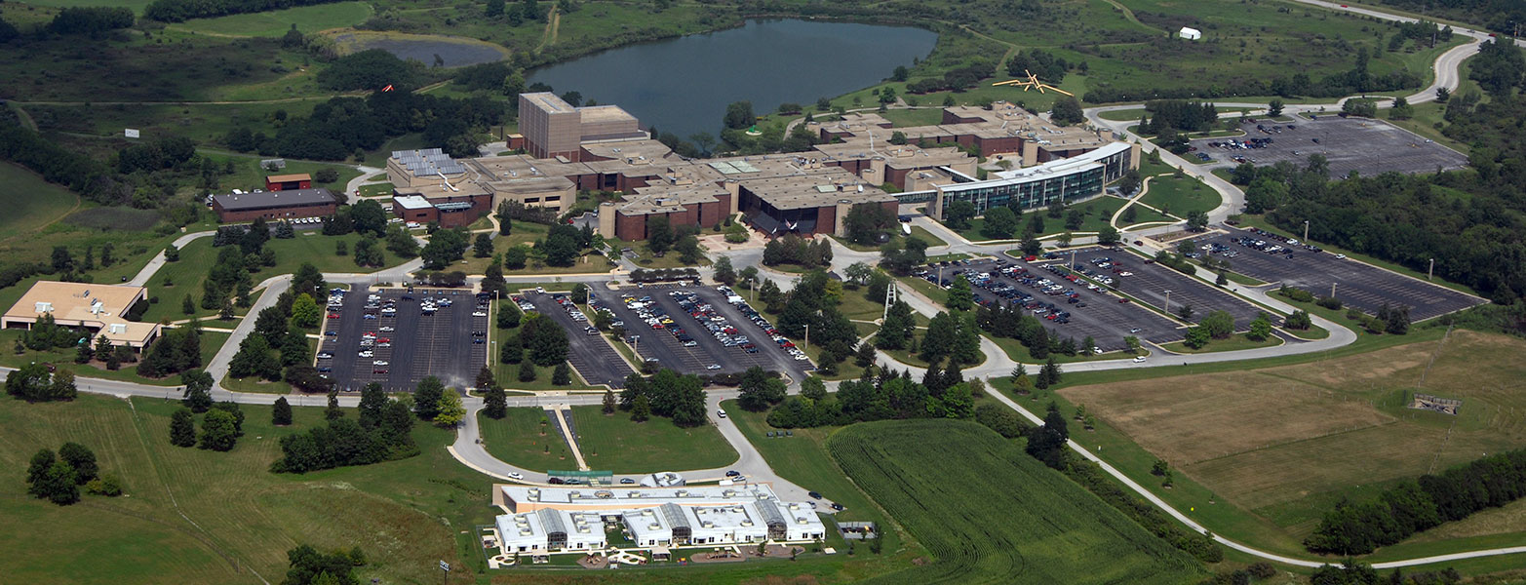
Governors State University
Mid-size university
Very diverse student population
Founded in 1969
Offering 85 different programs
https://www.govst.edu/about/

Slide 4
Background
Weeding
Monumental project
Total collection size before project 1,251,022
Of that, books and government documents – 254,934
New interim dean

Slide 5
Initial organization of systemic processes
A – General Works.
L – Education.
Q – Science.
U – Military Science.
R – Medicine.
Z – Bibliography. Library Science. Information Resources.
Determined sections by liaison areas

Slide 6
Public Services Librarian
Shared lists of collections with appropriate faculty librarians
Faculty Librarians
Reviewed lists and made recommendations
Shared recommendations with teaching faculty
Public Services Librarian
Shared final lists with staff and student workers for physical removal
Determined disposal options
Workflow

Slide 7
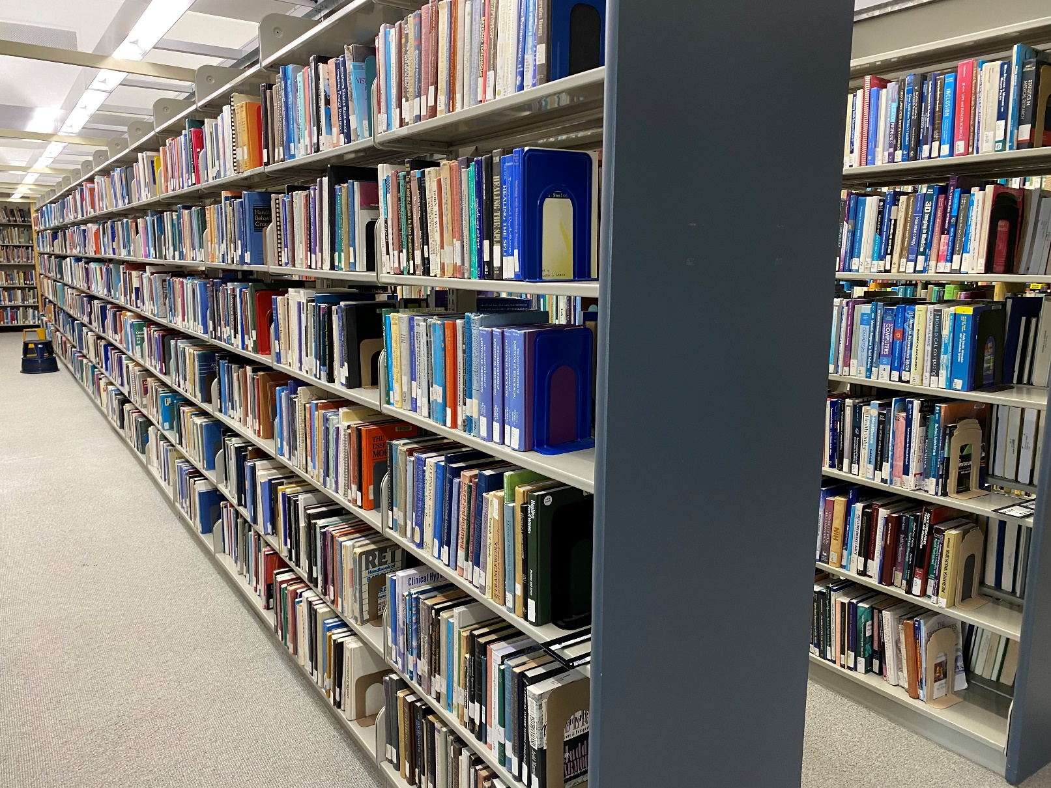
Progress
Rs (medical book collection)
Weeded the previous year
12,000 volumes down to approximately 3,000
Qs (science collection)
Weeded the previous year
12,300 volumes down to 2,300
Photo taken by Elizabeth Sterner, 4/4/2022
R’s before deselection initiated

Slide 8
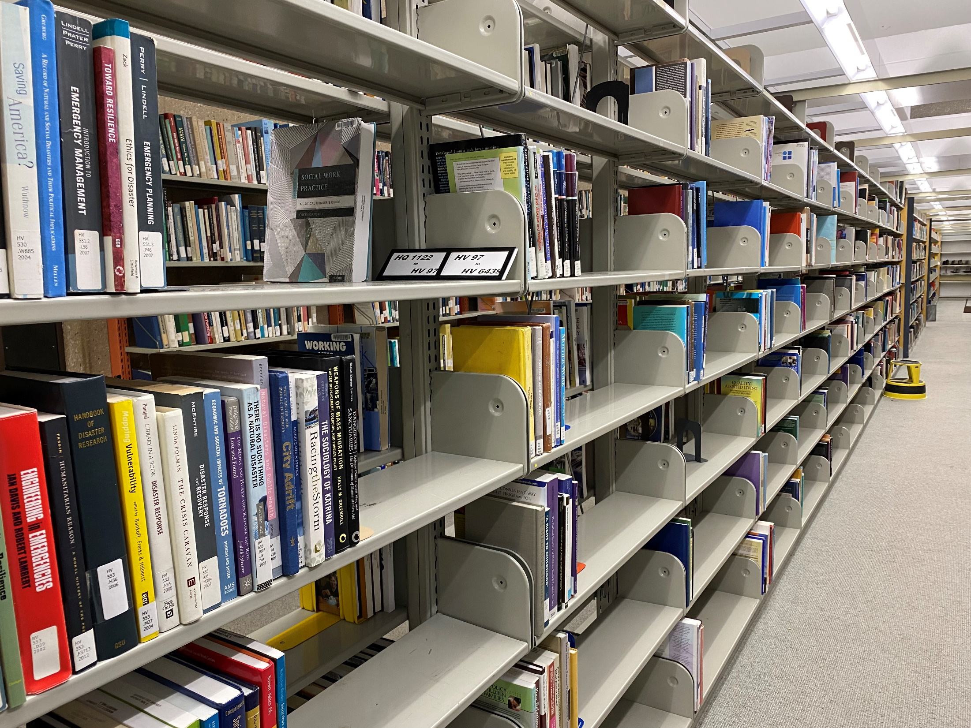
Progress
Photo taken by Elizabeth Sterner, 6/27/2022
HV’s after deselection

Slide 9
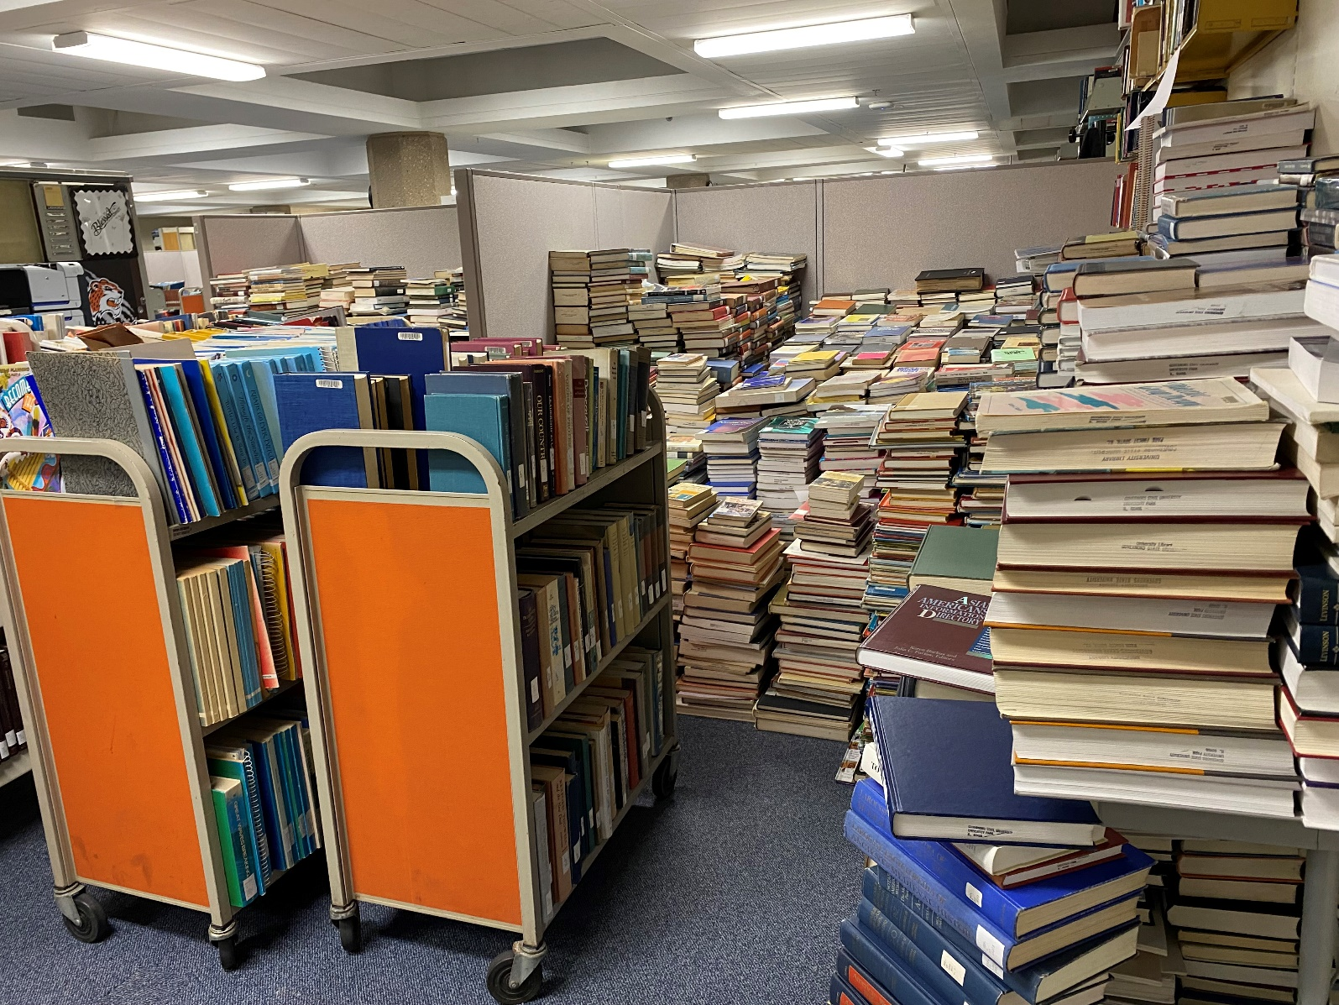
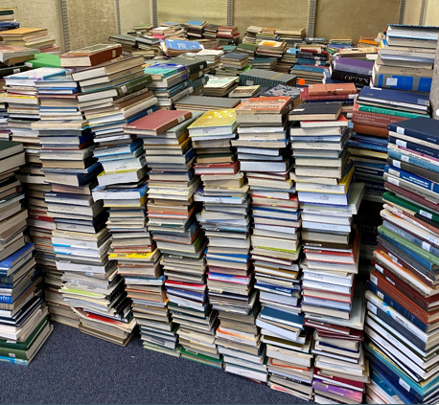
Photo taken by Elizabeth Sterner, 6/29/2022 After deselection
Progress
Photo taken by Elizabeth Sterner, 8/1/2022 After deselection

Slide 10
Challenges faced
Maintain consistency
Create deselection criteria
Make data driven decisions
Check consistently for Resources for College Libraries (RCL) recommendations
Include teaching faculty
Determine priorities
Purchase new materials
Continue weeding
Begin shifting

Slide 11
Lessons learned
• Maintain an effective workflow and professional communication
Map out a workflow
Clearly communicate the workflow
Maintain consistent communication
Follow created workflows and processes

Slide 12
Lessons learned
Set realistic goals
Allow appropriate timeframes to weed
Consider electronic resources
Avoid arbitrary deadlines
Maintain morale
Maintain consistent priorities
Be considerate of burnout amongst faculty, staff, and student workers

Slide 13
Thank you!
Elizabeth Sterner
Health and Human Services Librarian
Assistant Professor
Governors State University
www.govst.edu/library
esterner@govst.edu
Cari Didion
Education/Science Librarian
Assistant Professor
Governors State University
www.govst.edu/library
cdidion@govst.edu

