Slide 1
Local Outreach:
Planning institutional opportunities to enhance and engage a traveling exhibit
Presented by Ramune Kubilius at the HSLI annual conference September 22, 2023
Variation of presentation by Gretchen Neidhardt at the Midwest Chapter / Medical Library Association Virtual Conference, October 11-13, 2023
DOI: https://doi.org/10.18131/qb55j-p7j76
Galter Health Sciences Library and Learning Center,
Feinberg School of Medicine, Northwestern University

Slide 2
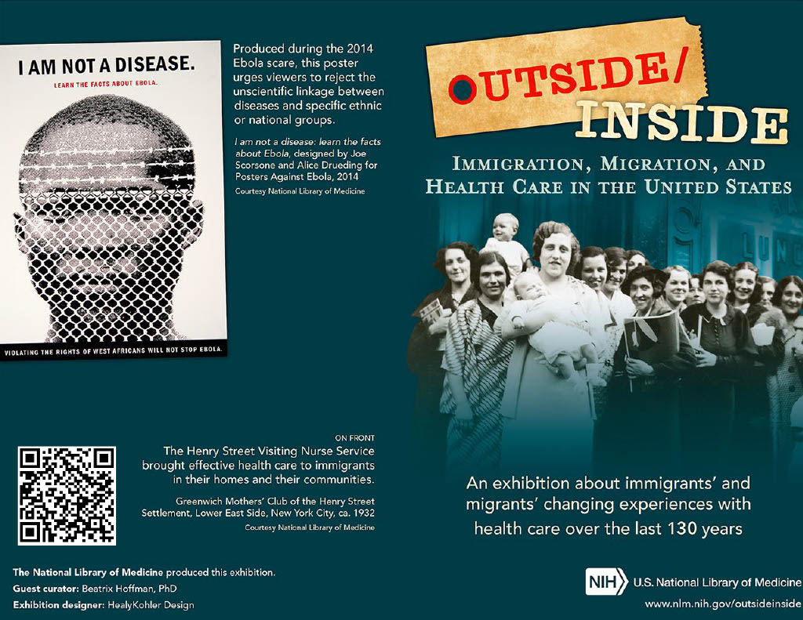
Timeline
September 15, 2022
Application entered in lottery to host exhibit in 2023
October 18, 2022
Notification received from NLM
December 2022 – May 2023
Planning task force creation and work period, selection and use of MOCHA
February 21: LibGuide activated
March 13 – April 22: Traveling exhibit at Galter
March 20: Local exhibit went live
March 22: Galter staff discussion
April 12: Invited panel (public event)
“A conversation: Immigration status,
health, and healthcare access”
May 10: Department lighting talks
Brochure for NLM traveling exhibit "Outside/Inside: Immigration, Migration and Health Care in the United States," hosted by Galter Health Sciences Library and Learning Center

Slide 3
Institutional opportunities
Using the exhibit as an opportunity to incorporate DEIA principles into routine work
Discussion session
Departmental lightning talks
Existing structure – DEIA Working Group
Used pre-existing material: NLM's university module, class 4 (Access and Empowerment)
Asked staff to engage with at least one listed resource deeply (images, annual reports, organization histories)
Used NLM-provided discussion questions, but also tailored additional questions to Galter staff interests (and took questions from participants)
New endeavor, but in existing all-staff meeting time
Idea formed in DEIA Working Group – brainstorming new ways to encourage incorporation of DEIA principles into daily work
Asked departments to present on a project related to exhibit themes – could be an existing project, new project, future project, or staff interest
Hoped to un-silo and de-mystify our departmental work
Spotlight: Exhibit- related projects – Group 1: Logistics & Highlights / Group 2: Immigration, Health, and Libraries
Group 1: NLM Exhibitions: Behind the Scenes (Administration); Outside / Inside the Cases: Curating an Exhibit on Healthcare and Immigration (Special Collections/Collection Management and Metadata Services); Highlighting Immigrant Health Workers Using LCNAF /*Library of Congress Name Authority File/ & Wikidata (Collection Management and Metadata Services)
Group 2: Meeting a need: Development and validation of PubMed search filters for immigrant health (Research and Information Services, Collection Management and Metadata Services); Books on Immigrant Health: a collection development and management pilot (Collection Management and Metadata Services); Out of Sight, Out of Mind: Externalizing Death at the Border (book talk on The Land of Open Graves by Jason De León) (Digital Systems)

Slide 4
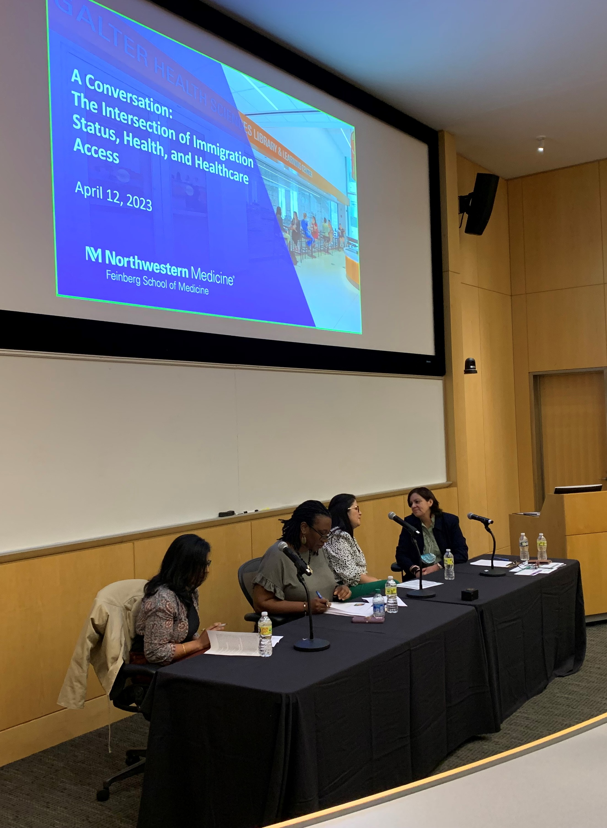
Local outreach
NLM exhibit posters outside Reading Room
Local exhibit in Eckenhoff Reading Room
Immigrant status and health panel
History of NLM Traveling Exhibit Outreach at Galter: https://www.mlanet.org/blog/what-we're-doing2

Slide 5
MOCHA process
Conclusions:
Helped make sure the small organizing team could coordinate with a larger group of people
Ensured the team contacted external participants with ample time before event
Kept us on track for our deadlines
Had to remember to constantly check in, had to have buy-in from everyone managing events
As events got closer to the deadline, our MOCHA spreadsheet wasn’t always updated
Manager-Owner-Consultant-Helper-Approver
Each event (stream) had MOCHA roles assigned, along with target dates
Each event then had all steps outlined with owner, consultants/helpers, due date, status, and timeline
Example:
Website: https://www.managementcenter.org/resources/frequently-asked-questions-about-mocha/

Slide 6
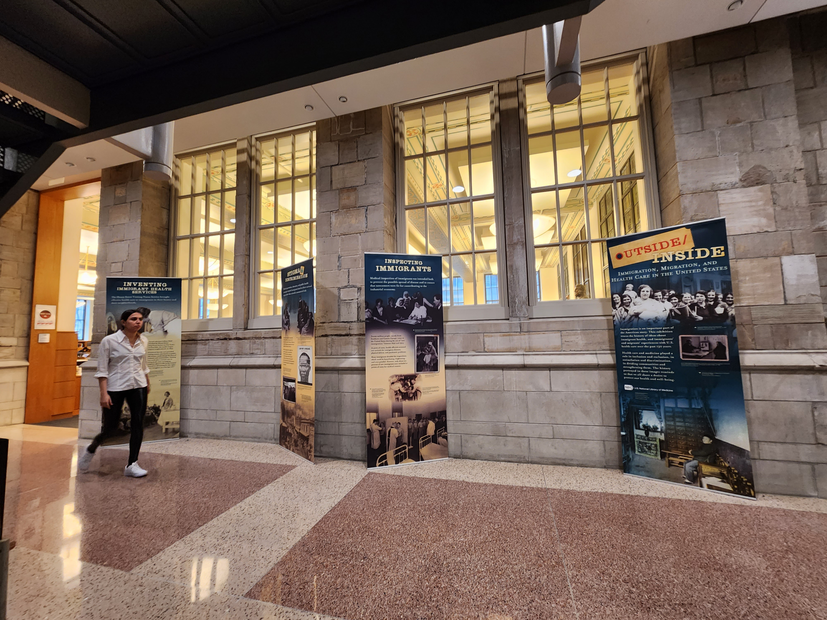
Takeaways
Hosting NLM exhibit was an excellent way to target outreach efforts around a theme
Organize as soon as possible – never can plan too early
MOCHA framework kept events organized if there was buy-in
Staff was interested, and meeting them where they already were led to more engagement
Many thanks to planning task force members: Mark Berendsen, Katie Lattal, Gretchen Neidhardt, and Mary Anne Zmaczynski. Questions? Gretchen.Neidhardt@northwestern.edu

