Slide 1
HSLI Annual Meeting
Sept. 22, 2023
Mary Beth Riedner
mbried@comcast.net

Slide 2
Can People Living With Dementia still read?
Freudenheim, Milt. (2010). “Many Alzheimer’s Patients Find Comfort in Books”. NYTimes.com. April 22, 2010. http://newoldage.blogs.nytimes.com/2010/04/22/many-alzheimers-patients-find-comfort-in-books/?_php=true&_type=blogs&_r=0
Bourgeois, M. (2001). Is reading preserved in dementia? The ASHA Leader. https://doi.org/10.1044/leader.FTR2.06092001.5
Claridge, G. and Rimkeit, S. (2018). Can she still read? How some people living with dementia responded to the reading experience. Extensive Reading World Congress, 4, 266-275.

Slide 3
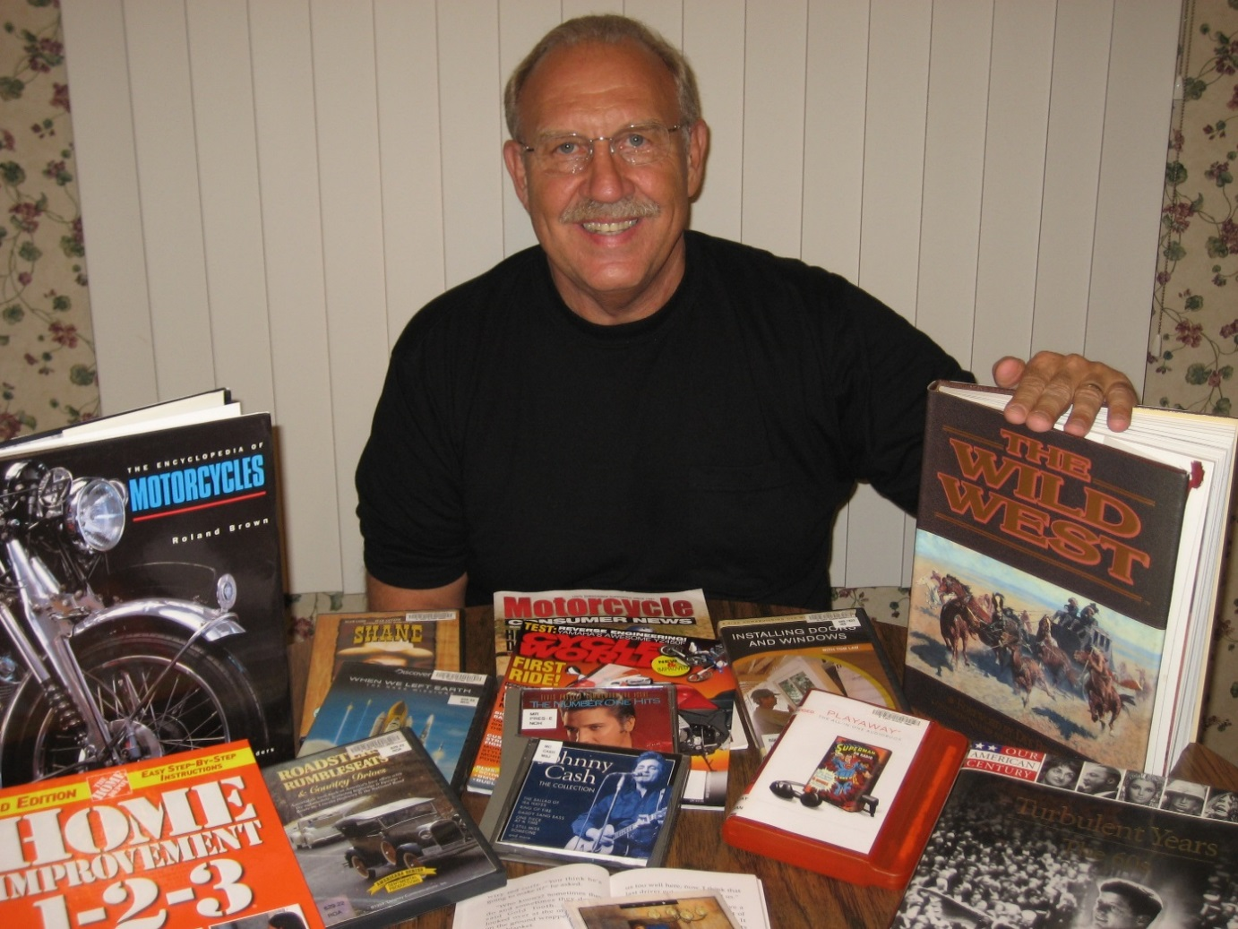
Content matters
Alzheimer’s Society. (2022). Person Centred Care - https://www.alzheimers.org.uk/about-dementia/treatments/person-centred-care
Benigas, J. and Bourgeois, M. (2011). Evaluating oral reading and reading comprehension in patients with dementia: A comparison of generic and personally relevant stimuli. Non-pharmacological Therapies in Dementia, 2(1): 41-54.
Bourgeois, M. (2001). Is reading preserved in dementia? The ASHA Leader. https://doi.org/10.1044/leader.FTR2.06092001.5

Slide 4
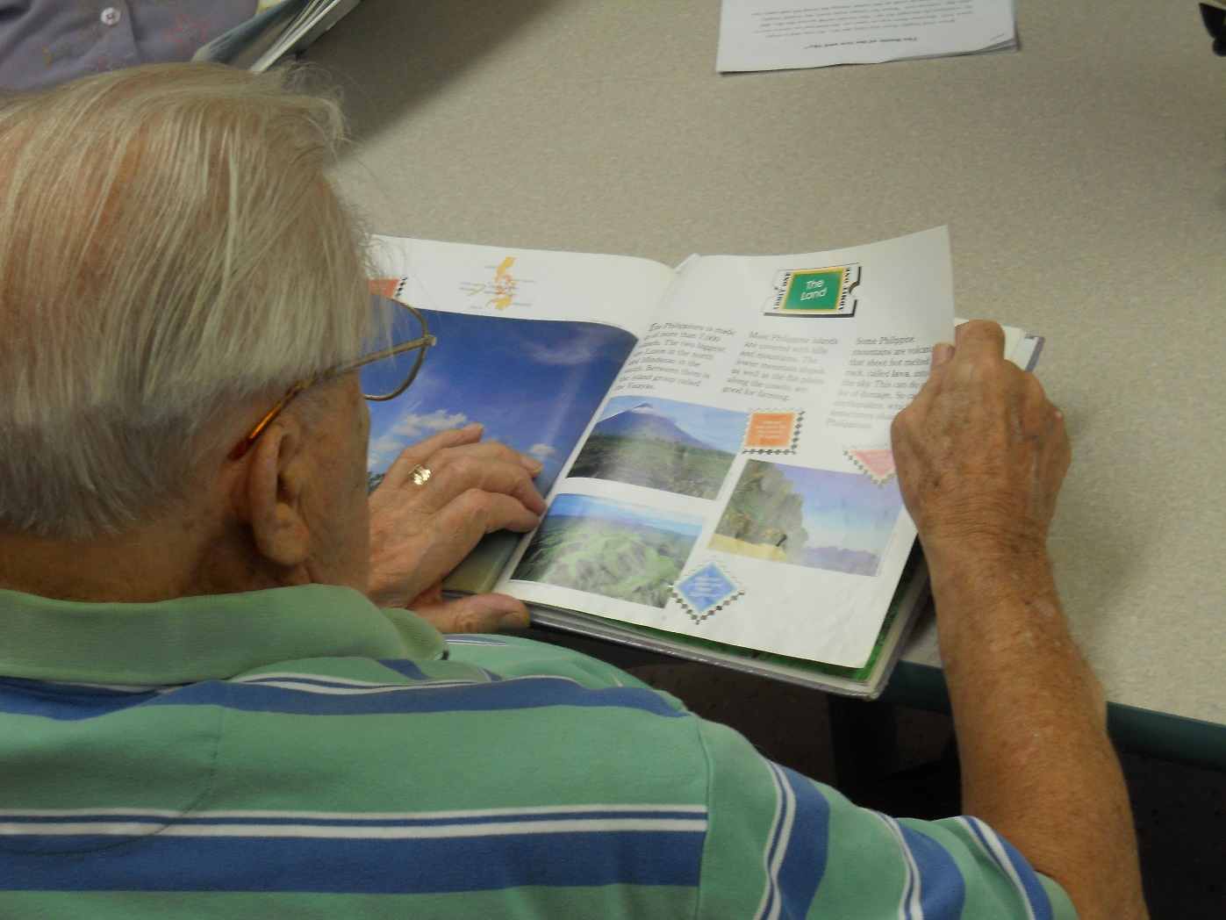
Format matters
Bourgeois, M. (2001) Is reading preserved in dementia? The ASHA Leader. https://doi.org/10.1044/leader.FTR2.06092001.5
Freund, Linda. (2019). Reading Improves Memory and Helps Prevent Dementia. Being Patient, May 13, 2019. https://www.beingpatient.com/reading-improves-memory-prevent-dementia/
IFLA Guidelines for Library Services to Persons with Dementia (2007). https://repository.ifla.org/bitstream/123456789/586/1/ifla-professional-reports-nr-104-en.pdf

Slide 5
Tales & Travel Studies
Tales & Travel Memories - http://talesandtravelmemories.com/
Tales & Travel Adventures -http://talesandtravelmemories.com/memory-cafes
Lytle, Miriam. (2016). Tales & Travel: Developing Community Partnerships to Expand Library Services. Project National Network of Libraries of Medicine: Greater Midwest Region, Target Award Final Report. http://talesandtravelmemories.com/wp-content/uploads/2019/03/NNLM-Final-Report-and-approval.pdf
Tales & Travel Study Results. http://talesandtravelmemories.com/wp-content/uploads/2019/03/Tales-and-Travel-Study-Results.pdf
Dai, J. et al. (2021). Library services enriching a community engagement for dementia care: The Tales & Travels Program at a Canadian Public Library as a case study. Journal of Librarianship and Information Science. https://journals.sagepub.com/doi/10.1177/09610006211065170#

